Slide 1
Programming for AI
Exploratory Data Analysis

Slide 2
Today’s Lecture
Exploratory Data Analysis (EDA)
EDA and Machine Learning Pipeline
EDA Steps
Data Analysis
Data Understanding
Univariate Analysis
Bivariate Analysis
Multivariate Analysis
Pandas Profiler (ydata-Profiling)
Data Preparation
Data Imputation
Feature Transformation
Feature Encoding
Feature Scaling
Feature Creation
Feature Selection
Column Transformer
Function Transformer
Sklearn Pipeline

Slide 3
Exploratory Data Analysis (EDA)
Exploratory Data Analysis (EDA) is a crucial initial step in any data science project.
It involves investigating, summarizing, and visualizing a dataset to gain insights into its characteristics, patterns, and potential relationships between variables.
Overall, EDA is an iterative process where you continuously explore and refine your understanding of the data.
It sets the stage for more sophisticated analysis by helping you ask the right questions and choose the most appropriate techniques for your data.

Slide 4
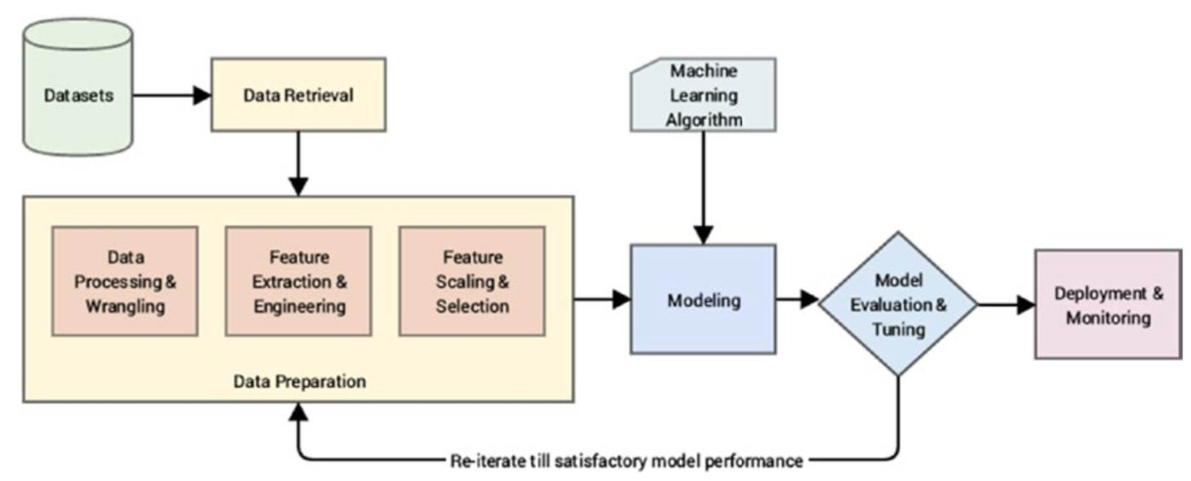
EDA and Machine Learning Pipeline

Slide 5
EDA Steps
Data Analysis
Data Understanding
Univariate Analysis
Bivariate Analysis
Multivariate Analysis
Pandas Profiler (ydata-Profiling)
Data Preparation
Data Imputation
Feature Transformation
Feature Encoding
Feature Scaling
Feature Creation
Feature Selection
Sklearn Pipeline

Slide 6
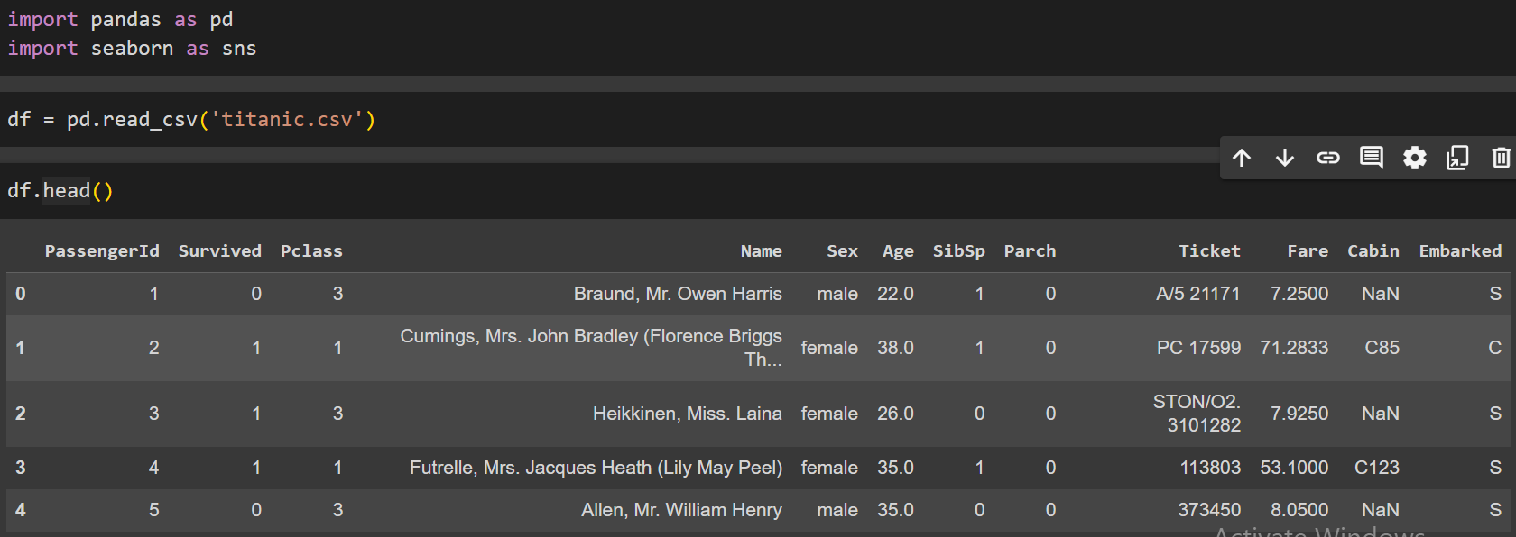
Data Reading
df.read_csv(“file.csv”)

Slide 7
Data Understanding
Data Understanding is a crucial step in Exploratory Data Analysis (EDA) where the main objective is to gain insights into the dataset and understand its structure, content, and characteristics.
This step involves examining and familiarizing oneself with the data to form a solid foundation for subsequent analysis.
The main steps questions we ask in data understanding are:
How big is the data?
What are features and their values in the data?
What is the data type of the features?
Are there any missing values?
How does the data look like mathematically?
Are there any duplicate values?

Slide 8
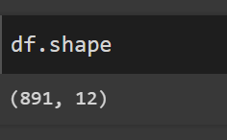
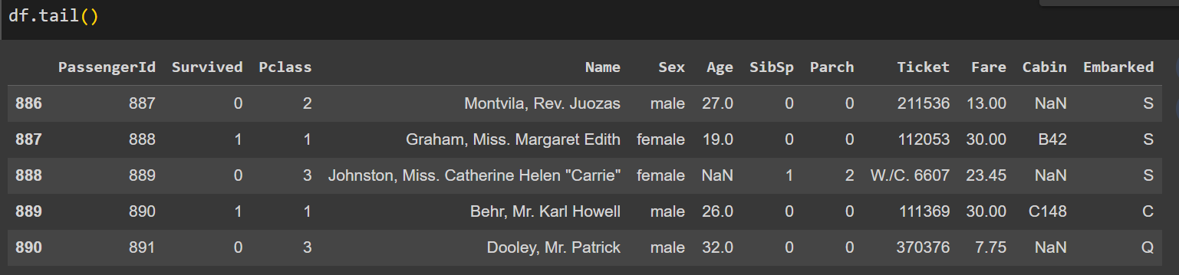
Data Understanding
How big is the data?
df. shape
What are features and their values in the data?
df.head() and df.tail()

Slide 9
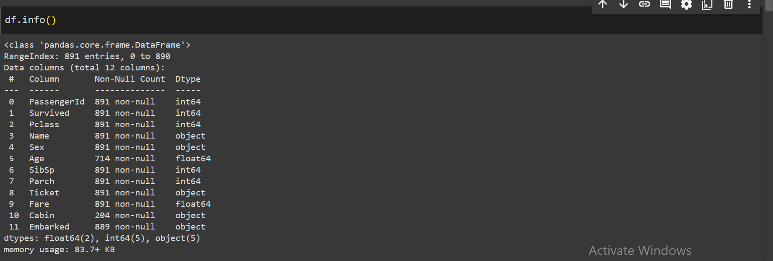
Data Understanding
What is the data type of the features?
df.info()

Slide 10
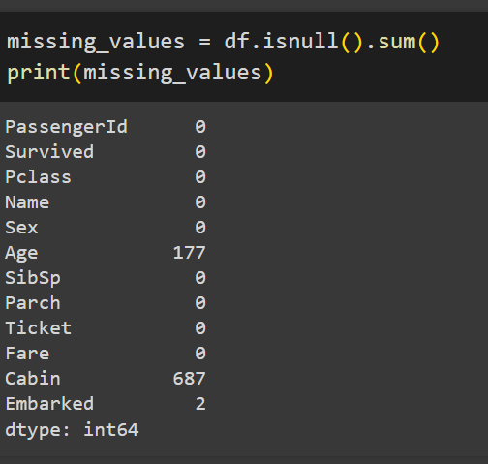
Data Understanding
Are there any missing values?
df.isnull().sum

Slide 11
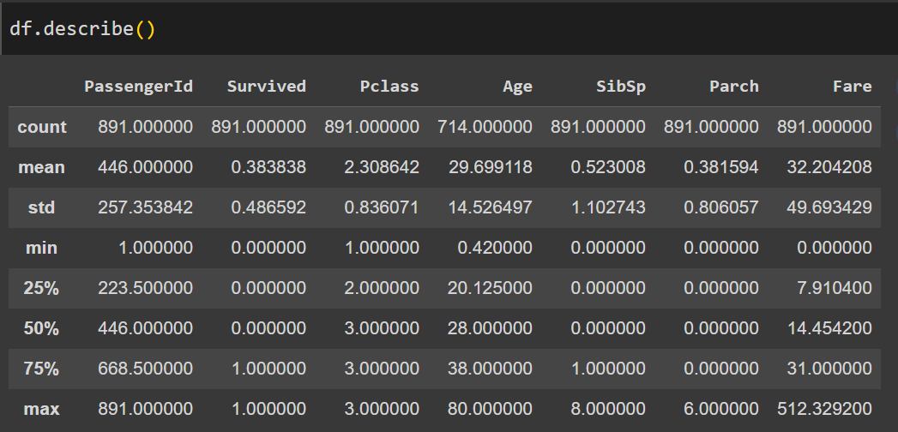
Data Understanding
How does the data look like mathematically?
df.describe()

Slide 12
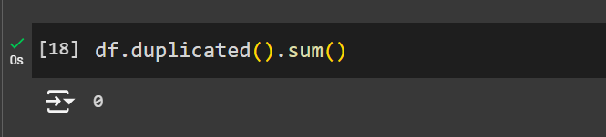
Data Understanding
Are there any duplicate values?
df.duplicated().sum()

Slide 13
Univariate Analysis
Univariate analysis explores each variable in a dataset separately. Variable is of two main types:
Categorical Data (such as country, gender etc.)
Numerical Data (such as weight, age etc.)
Mixed Type (Name, Ticket No etc.)
Univariate analysis for categorical data involves examining the distribution and characteristics of a single categorical variable.
It aims to understand the frequency of each category within the variable and any patterns or trends that may exist.

Slide 14
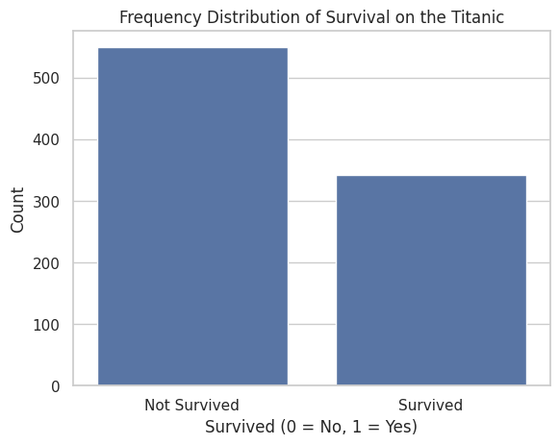
Univariate Analysis (Categorical Data)
The univariate analysis can be performed for categorical data in the following ways:
Bar Chart: Calculate the frequency or count of each category in the categorical variable. sns.countplot(x='Survived', data=df)

Slide 15
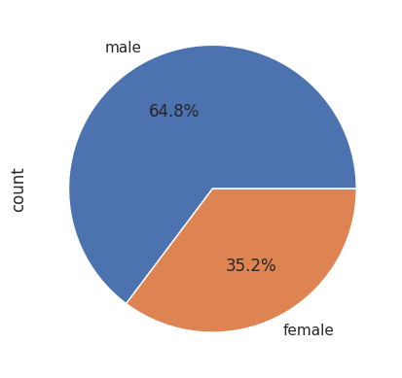
Univariate Analysis (Categorical Data)
Percentage Distribution: Calculate the percentage or proportion of each category relative to the total number of observations. df['Sex'].value_counts().plot(kind='pie',autopct='%0.1f%%')

Slide 16
Univariate Analysis (Numerical Data)
Univariate analysis for numerical data involves exploring the distribution and characteristics of a single numerical variable.
Here's how univariate analysis can be performed for numerical data:
Mean: Calculate the arithmetic average of the data points. It gives an indication of the central tendency of the data.
Median: Determine the middle value of the dataset when it is sorted in ascending order. It is less sensitive to outliers than the mean and provides a robust measure of central tendency.

Slide 17
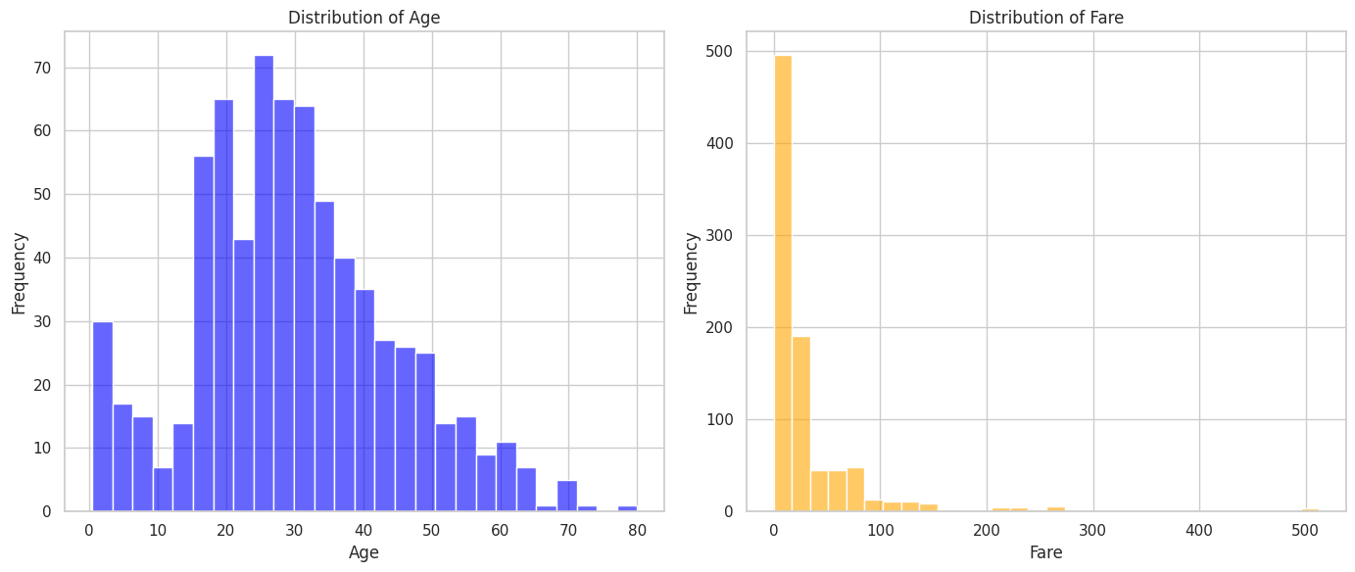
Univariate Analysis (Numerical Data)
Skewness: Assess the asymmetry and tail heaviness of the distribution. Skewness measures the deviation from symmetry.
Histogram:
Create a histogram to visualize the frequency distribution of the numerical variable.
It divides the range of the variable into bins and displays the count or density of observations in each bin.
sns.histplot(titanic['age'], bins=27, color='blue', alpha=0.6)
sns.histplot(titanic['fare'], bins=30, color='orange', alpha=0.6)

Slide 18
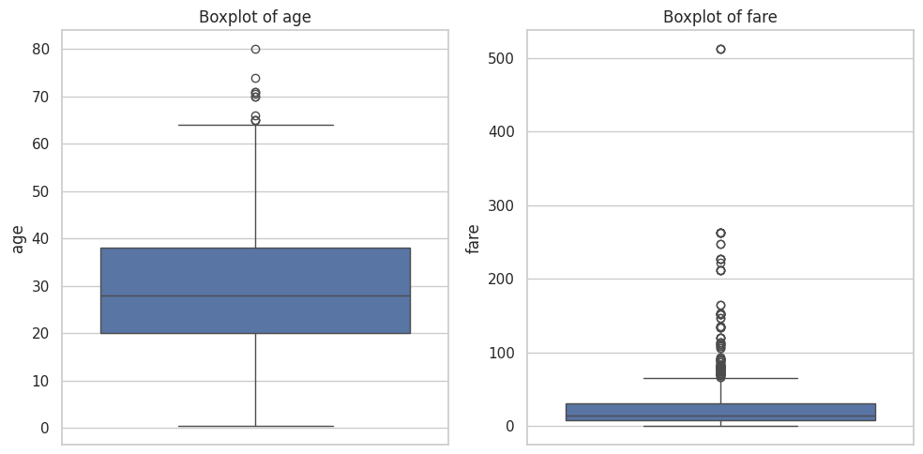
Univariate Analysis (Numerical Data)
Box Plot: Construct a box plot (box-and-whisker plot) to display the distribution of the numerical variable, including its median, quartiles, and outliers.
Box plots are useful for detecting skewness, outliers, and variability in the data.
sns.boxplot(y=titanic[age])
sns.boxplot(y=titanic[fare])

Slide 19
How to Interpret a Boxplot?
A boxplot is a graphical representation of the distribution of a dataset based on five key summary statistics:
Minimum – The smallest value (excluding outliers).
First Quartile (Q1) – The 25th percentile (lower quartile).
Median (Q2) – The 50th percentile (middle value).
Third Quartile (Q3) – The 75th percentile (upper quartile).
Maximum – The largest value (excluding outliers).
It also displays outliers as individual points beyond the whiskers.
Box (IQR: Interquartile Range) → Shows the middle 50% of the data (Q1 to Q3).
Line inside the box → Represents the median (Q2).
Whiskers → Extend to the lowest and highest values within 1.5 times the IQR.
Dots outside the whiskers → Indicate outliers (values beyond 1.5×IQR).

Slide 20
Bivariate Analysis
Bivariate analysis is a statistical method used to analyze the relationship between two variables simultaneously.
It explores the association, correlation, or dependency between two variables to understand how changes in one variable are related to changes in another.
In bivariate analysis, the two variables being studied are typically referred to as the independent variable and the dependent variable.
The independent variable is the variable that is manipulated or controlled by the researcher, while the dependent variable is the variable that is observed and measured to see how it responds to changes in the independent variable.

Slide 21
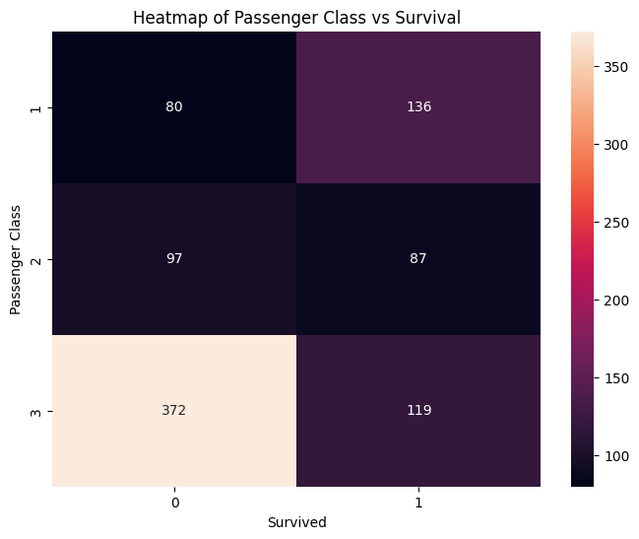
Bivariate Analysis
Bivariate analysis can involve various statistical techniques and visualizations depending on the types of variables being studied:
Categorical vs. Categorical Variables: For categorical variables, bivariate analysis often involves heatmap, contingency table etc.
Heatmaps for bivariate analysis typically display the magnitude or strength of the relationship between variables using color gradients.
sns.heatmap(pd.crosstab(titanic['pclass'], titanic['survived']),annot=True,fmt='d')

Slide 22
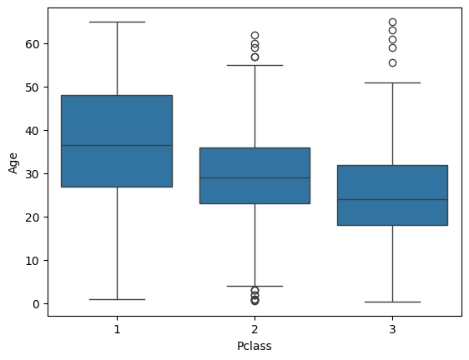
Bivariate Analysis
Categorical vs. Numerical Variables: When one variable is categorical and the other is numerical (also known as quantitative or continuous), bivariate analysis may involve comparing the distribution of the numerical variable across different categories of the categorical variable using techniques such as box plots or histograms etc.

Slide 23
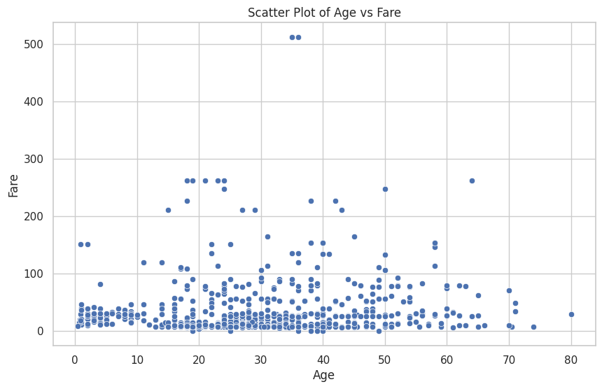
Bivariate Analysis
Numerical vs. Numerical Variables: For two numerical variables, bivariate analysis focuses on exploring the relationship between the variables through techniques such as scatter plots and correlation analysis.
Scatter plots visually represent the relationship between the variables.
sns.scatterplot(x='age', y='fare', data=titanic)

Slide 24
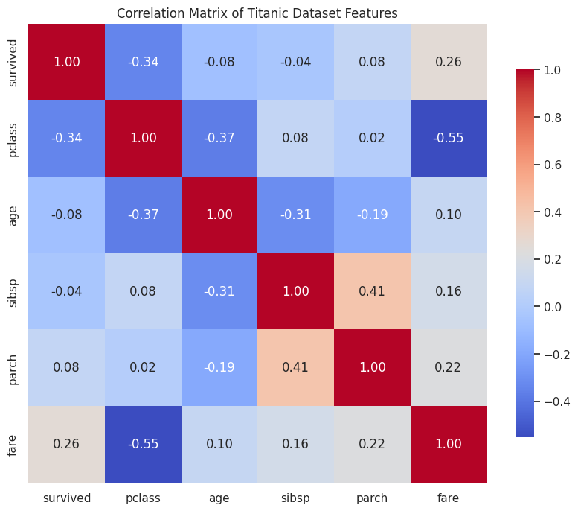
Bivariate Analysis
Correlation analysis quantifies the strength and direction of the linear relationship between the variables using correlation coefficients (e.g., Pearson correlation coefficient).

Slide 25
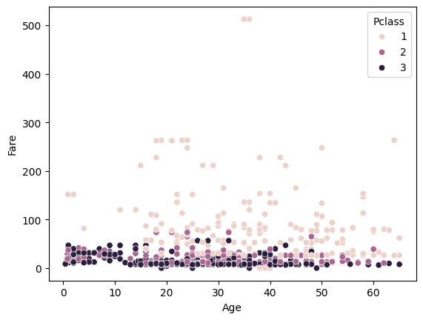
Multivariate Analysis
Multivariate analysis is a statistical technique used to analyze data that involves multiple variables simultaneously.
It aims to understand the relationships and interactions between these variables, making it possible to identify patterns, correlations, and underlying structures in the data.

Slide 26
Pandas Profiling
Pandas Profiling (now ydata-profiling) is a Python library that generates an exploratory analysis report for a DataFrame in pandas.
This report provides a comprehensive summary of the dataset's characteristics, including descriptive statistics, data types, missing values, correlations, and visualizations.
Pandas Profiling aims to automate and streamline the process of data exploration and preliminary analysis.
Here are some key features of Pandas Profiling:
Descriptive Statistics: Pandas Profiling generates descriptive statistics for each numerical and categorical variable in the DataFrame, including count, mean, median, minimum, maximum, standard deviation, and quantiles.
Data Types: It provides an overview of the data types of each column in the DataFrame, including numerical, categorical, and datetime types.
Missing Values: Pandas Profiling identifies missing values in the dataset and provides information about the percentage of missing values for each column.

Slide 27
Pandas Profiling
Correlations: It calculates pairwise correlations between numerical variables and visualizes them using correlation matrices and heatmap plots. This helps identify linear relationships between variables.
Distribution Plots: Pandas Profiling generates histograms and kernel density plots to visualize the distribution of numerical variables. For categorical variables, it provides bar plots showing the frequency of each category.
Unique Values: It lists the unique values and their frequencies for each categorical variable, helping identify potential data quality issues or inconsistencies.
Interactions: Pandas Profiling identifies potential interactions between variables by generating scatter plots, pair plots, and parallel coordinates plots for numerical variables.
Exporting Reports: The generated analysis report can be exported to various formats, including HTML, JSON, and interactive HTML formats.

Slide 28
Pandas Profiling
!pip install ydata-profiling
import pandas as pd
from ydata_profiling import ProfileReport
df=pd.read_csv('titanic.csv')
prof = ProfileReport(df)
prof.to_file(output_file='eda.html')

Slide 29
Data Preparation
Data Preparation is a critical step in Exploratory Data Analysis (EDA) where the main objective is to preprocess, and transform the raw data into a format suitable for analysis.
This step ensures that the data is of high quality, consistent, and ready for further exploration and modeling.
Data Imputation
Feature Transformation
Feature Encoding
Feature Scaling
Feature Creation
Feature Selection

Slide 30
Data Imputation
Data imputation in exploratory data analysis (EDA) refers to the process of filling in missing values in a dataset.
Missing data is a common issue in real-world datasets and can arise due to various reasons such as human error, malfunctioning sensors, or data corruption during collection or storage.
Imputing missing values is important because many statistical and machine learning algorithms cannot handle missing data.

Slide 31
Data Imputation
Therefore, imputation aims to replace missing values with estimated or predicted values based on the available data.
There are several common methods for data imputation in EDA:
Mean/Median/Mode Imputation:
Replace missing values with the mean, median, or mode of the non-missing values in the same column.
# Mean Imputation for the 'Age' column (numerical)
titanic['age'].fillna(titanic['age'].mean(), inplace=True)
# Mode Imputation for the 'Embarked' column (categorical)
titanic['embarked'].fillna(titanic['embarked'].mode()[0], inplace=True)

Slide 32
Data Imputation Techniques
Forward Fill (or Backward Fill) Imputation:
Propagate the last (or next) observed value forward (or backward) to fill missing values.
This method is suitable for time-series data where the missing values are assumed to follow the trend of the observed data.
titanic['age'].fillna(method='ffill', inplace=True)
Interpolation:
Estimate missing values based on the values of neighboring data points.
Linear interpolation, spline interpolation, or other interpolation techniques can be used depending on the nature of the data.
titanic['age'].interpolate(method='linear',inplace=True)
K-Nearest Neighbors (KNN) Imputation:
Estimate missing values by averaging the values of the nearest neighbors in the feature space.
This method considers the similarity between data points and is useful when the dataset has complex patterns or relationships.

Slide 33
Feature Transformation
Feature transformation is the process of converting or modifying the features (variables) in a dataset to make them more suitable for analysis or modeling.
It involves applying various mathematical or statistical transformations to the original features to extract more useful information, improve the performance of machine learning models, or meet specific requirements of the analysis.
Feature transformation can include a wide range of techniques, including:
Feature Encoding
Feature Scaling
Outlier Detection
Renaming Columns
Identifying Duplicate Rows
Handling Irrelevant Columns and Rows

Slide 34
Feature Encoding
In the context of exploratory data analysis (EDA), feature encoding refers to the process of converting categorical or textual data into a numerical format that can be used for analysis and modeling.
Feature encoding is essential because many machine learning algorithms and statistical techniques require numerical inputs.
Ordinal Encoding
One-Hot Encoding
Label Encoding

Slide 35
Ordinal Encoding
OrdinalEncoder is specifically designed to handle ordinal data where the order of categories is important.
It encodes the categories in the given order, ensuring that the numbers reflect the correct ranking of the data.
For example, "low", "medium", and "high" have a natural order, and ordinal encoding ensures this order is preserved in the numerical values.
oe = OrdinalEncoder(categories=[['Poor','Average','Good'],['School','UG','PG']])

Slide 36
One-Hot Encoding
One-Hot Encoding is a technique used to convert categorical variables into a binary (0 or 1) representation, where each unique category in the original feature is transformed into a new binary feature (column).
Using pandas library
pd.get_dummies(df,columns=['fuel','owner'])
Using sklearn library
ohe= OneHotEncoder()
X_train_new = ohe.fit_transform(X_train[['fuel','owner']])

Slide 37
Label Encoding
Label Encoding is a technique used in machine learning to convert categorical data (features or target variables) into numerical labels..
Often used when the target variable has categorical classes (e.g., binary classification: 'Yes', 'No' or multi-class classification: 'Dog', 'Cat', 'Rabbit').
Assigns a unique numerical value to each category. For example, if you have categories like "Red," "Green," and "Blue," you might assign them 0, 1, and 2 respectively.
colors = ['red', 'blue', 'green']
# Fit and transform the data
encoded_colors = label_encoder.fit_transform(colors)

Slide 38
Feature Scaling
Feature scaling is a technique used in machine learning to normalize the range of independent variables or features of the data.
In many machine learning algorithms, the distance between data points influences the model's performance.
Features on different scales can disproportionately affect the model, leading to suboptimal performance.
Min-Max Scaling (Normalization)

Slide 39
Feature Creation
Feature creation is the process of generating new features from existing data to improve the performance of machine learning models.
It involves transforming raw data into meaningful features that make patterns more visible to the model, thus increasing its predictive power.
Consider the Titanic dataset. Some of the passengers' names contain titles like "Mr.", "Mrs.", or "Dr.", which can provide additional information about the passenger's social status or occupation.
# Example of creating a new feature 'FamilySize' by summing SibSp and Parch
data['FamilySize'] = data['SibSp'] + data['Parch'] + 1

Slide 40
Column Transformer
ColumnTransformer is a class in the sklearn.compose module of the scikit-learn library that allows you to apply different preprocessing steps to different columns of a dataset within a single pipeline.
It is particularly useful for datasets that contain both numerical and categorical features, as it enables you to handle each type of data appropriately.
You can specify different transformers for different columns or sets of columns. For instance, you might want to standardize numerical features while encoding categorical features.
ColumnTransformer applies transformations in parallel for the different columns or groups of columns specified in its configuration..

Slide 41
Column Transformer (Example)
# Sample DataFrame
data = pd.DataFrame({
'Age': [22, None, 24, 22, None, 24],
'Sex': ['male', 'female', 'female','male', 'female', 'female'],
'Embarked': ['B', 'B', 'C','C', 'C','S'],
'Fare': [7.25, 71.83, 8.05,7.25, 71.83, 8.05]
})
#Apply ColumnTransformer
preprocessor = ColumnTransformer(transformers=[
('age_imputer', SimpleImputer(strategy='mean'), ['Age']),
('ohe', OneHotEncoder(), ['Sex','Embarked'])
], remainder='passthrough') # Pass through other columns like 'Fare'
# Transform the data
transformed_data = preprocessor.fit_transform(data)

Slide 42
Output
Original DataFrame:
Age Sex Embarked Fare
0 22.0 male B 7.25
1 NaN female B 71.83
2 24.0 female C 8.05
3 22.0 male C 7.25
4 NaN female C 71.83
5 24.0 female S 8.05
Transformed Data Shape:
(6, 7)
[[22. 0. 1. 1. 0. 0. 7.25]
[23. 1. 0. 1. 0. 0. 71.83]
[24. 1. 0. 0. 1. 0. 8.05]
[22. 0. 1. 0. 1. 0. 7.25]
[23. 1. 0. 0. 1. 0. 71.83]
[24. 1. 0. 0. 0. 1. 8.05]]

Slide 43
Function Transformer
FunctionTransformer is a utility in Scikit-learn that allows you to create a transformer from a custom function.
It is particularly useful when you want to apply a specific function to your data during the preprocessing step.
This flexibility enables you to integrate custom transformations into Scikit-learn’s pipeline and ColumnTransformer workflows.

Slide 44
Function Transformer (Example)
# Sample DataFrame
data = pd.DataFrame({
'Age': [22, None, 24, 22, None, 24],
'Sex': ['male', 'female', 'female','male', 'female', 'female'],
'Embarked': ['B', 'B', 'C', None, 'C','S'],
'Fare': [7.25, 71.83, 8.05,7.25, 71.83, 8.05]
})
# Custom function to impute 'Embarked'
def impute_embarked(X):
X['Embarked'] = ['Embarked'].fillna(X['Embarked'].mode()[0])
return X

Slide 45
Function Transformer (Contd..)
#Apply ColumnTransformer
preprocessor = ColumnTransformer(transformers=[
('age_imputer', SimpleImputer(strategy='mean'), ['Age']),
('embarked_imputer', FunctionTransformer(impute_embarked), ['Embarked']),
('ohe', OneHotEncoder(), ['Sex','Embarked'])
], remainder='passthrough') # Pass through other columns like 'Fare'
# Transform the data
transformed_data = preprocessor.fit_transform(data)

Slide 46
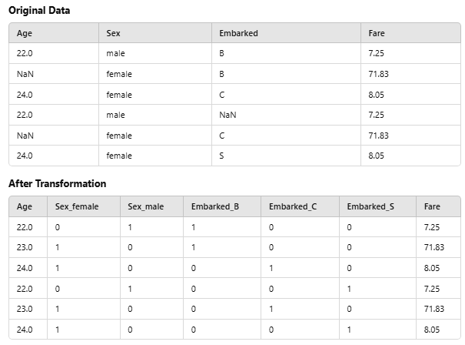

Slide 47
Pipeline
In scikit-learn (sklearn), a pipeline is a sequence of data processing steps combined into a single object.
Pipeline allows you to sequentially apply a list of transformers to preprocess the data and, if desired, conclude the sequence with a final predictor for predictive modeling.
Pipelines are useful for encapsulating multiple preprocessing steps and modeling steps into a single entity, making it easier to manage and apply the entire workflow consistently.
This can include feature encoding, feature scaling, feature selection, model training, and prediction.

Slide 48
Pipeline (Example)
# Sample DataFrame
data = pd.DataFrame({
'Age': [22, None, 24, 22, None, 24],
'Sex': ['male', 'female', 'female','male', 'female', 'female'],
'Embarked': ['B', 'B', 'C',None, 'C','S'],
'Fare': [7.25, 71.83, 8.05,7.25, 71.83, 8.05]
})
# Custom function to impute 'Embarked'
def impute_embarked(X):
X['Embarked'] = X['Embarked'].fillna(X['Embarked'].mode()[0])
return X
#Apply ColumnTransformer

Slide 49
Pipeline Example (Contd..)
preprocessor = ColumnTransformer(transformers=[
('age_imputer', SimpleImputer(strategy='mean'), ['Age']),
('embarked_encoder', Pipeline(steps=[
('imputer', FunctionTransformer(impute_embarked)),
('onehot', OneHotEncoder())
]), ['Embarked']),
('ohe', OneHotEncoder(), ['Sex'])
], remainder='passthrough') # Pass through other columns like 'Fare'
# Transform the data
transformed_data = preprocessor.fit_transform(data)

Slide 50
Output
Original DataFrame:
Age Sex Embarked Fare
0 22.0 male B 7.25
1 NaN female B 71.83
2 24.0 female C 8.05
3 22.0 male C 7.25
4 NaN female C 71.83
5 24.0 female S 8.05
Transformed Data Shape:
(6, 7)
[[22. 1. 0. 0. 0. 1. 7.25]
[23. 1. 0. 0. 1. 0. 71.83]
[24. 0. 1. 0. 1. 0. 8.05]
[22. 0. 1. 0. 0. 1. 7.25]
[23. 0. 1. 0. 1. 0. 71.83]
[24. 0. 0. 1. 1. 0. 8.05]]

Slide 51
Today’s Lecture
Exploratory Data Analysis (EDA)
EDA and Machine Learning Pipeline
EDA Steps
Data Analysis
Data Understanding
Univariate Analysis
Bivariate Analysis
Multivariate Analysis
Pandas Profiler (ydata-Profiling)
Data Preparation
Data Imputation
Feature Transformation
Feature Encoding
Feature Scaling
Feature Creation
Feature Selection
Column Transformer
Function Transformer
Sklearn Pipeline

Slide 52
References
https://pypi.org/project/pandas-profiling/
https://scikit-learn.org/stable/modules/generated/sklearn.pipeline.Pipeline.html#:~:text=Pipeline%20allows%20you%20to%20sequentially,implement%20fit%20and%20transform%20methods.
https://scikit-learn.org/1.5/modules/generated/sklearn.compose.ColumnTransformer.html
https://scikit-learn.org/dev/modules/generated/sklearn.preprocessing.FunctionTransformer.html
https://scikit-learn.org/1.5/modules/generated/sklearn.pipeline.Pipeline.html

